Slide 1




.
CS 460 – Software Engineering for Mobile Devices
Dr. Adriano Cavalcanti
PhD MABE, MS EE, BSc CSc
Computational Nanotechnology & Biomed Robotics
Office location: Hebeler 107 - Phone 509-963-2063
Email: adriano.cavalcanti@cwu.edu
Office hours:
Mon Tue Wed 2:00pm-3:00pm; Or by appointment

Slide 2












Menu App
Team of Two Students

Slide 3
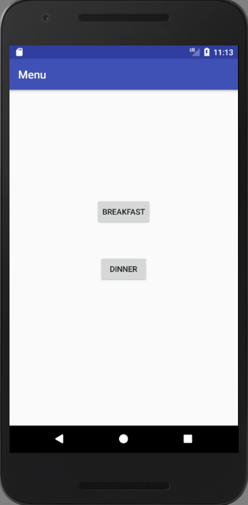
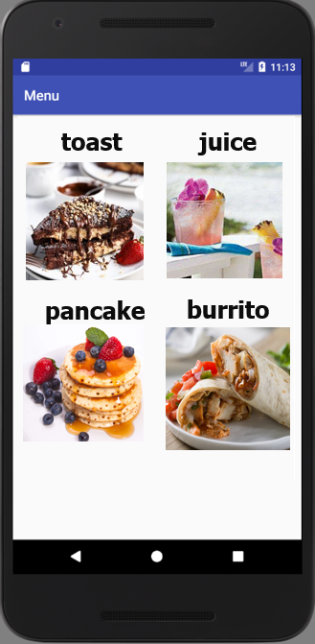
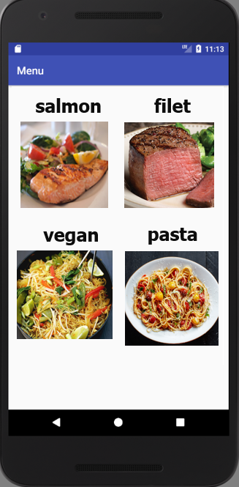



Slide 4
Menu App
Develop an App for a restaurant menu with the following features:
Pick from from the main activity buttons: breakfast or dinner; (3 points)
Have a Grid showing the items for breakfast/dinner; (3 point)
Make the Grid interactive – every time the user click on each item, use Toast to show the the item selected; (4 points)

